Slide 1

Sentiment Data Analysis using
Machine Learning
Name1
Name2
Name3
Name4

Slide 2




Goal
TRAIN DIFFERENT MACHINE LEARNING MODELS
COMPARE EACH MODEL’S ACCURACY

Slide 3
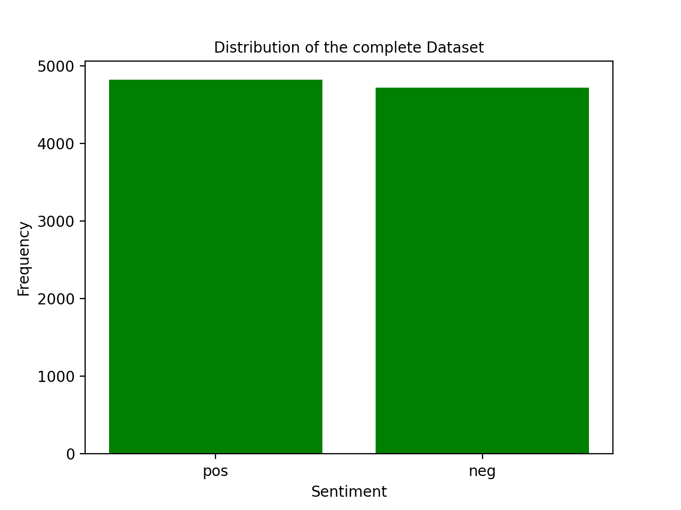
Initial Data
Data | Frequency
POS | 4817
NEG | 4714

Slide 4
Data set analysis
Huge number of records > 10000 reviews
Only 2 labels to predict “pos , neg”
The only features that can be used are the words in each review which is associated to a label. In similar way to filtering spam emails
Different length between records which can effect the probability of predicating the correct label since shorter reviews will have a higher probability to get the wrong label
The data distribution between the 2 labels is very close which can be a good factor while calculating the accuracy of the learning model

Slide 5
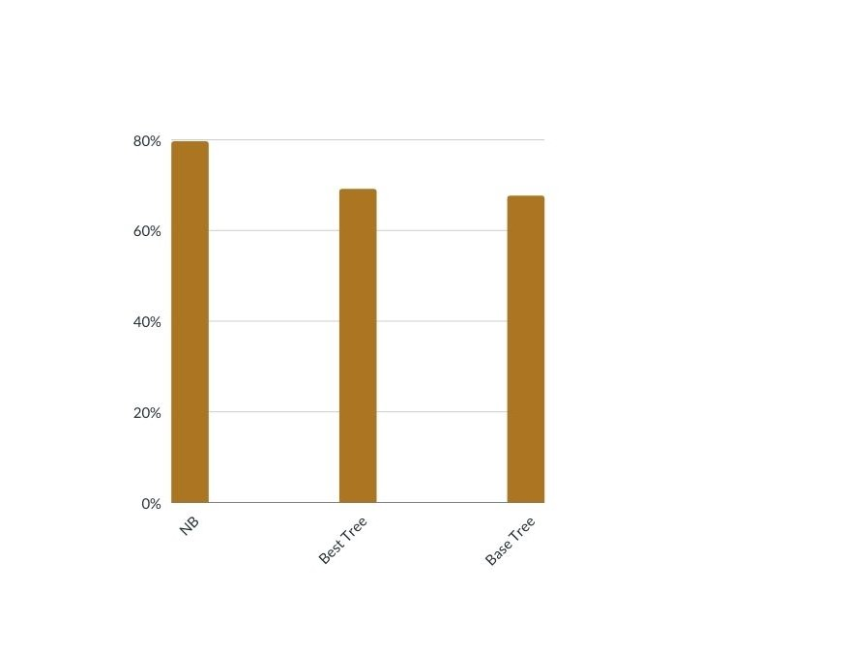
Machine learning data models
We have used 3 models to predict the labels for each review in the evaluation set so we got a different results for each learning model.
The models ranking based on their performance:
The Naive Bayes classifier which was the most accurate model
The Best decision tree which was less accurate than NB model but more accurate than the Base decision tree
The Base decision tree which was the least accurate model of the three

Slide 6
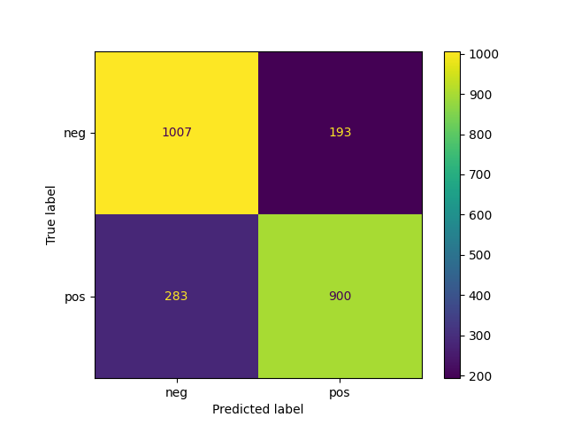
Naive Bayes classifier
The results for this model were the best in comparison to the other 2 models
The confusion matrix
Accuracy | Precision | Recall | Fscore
0.8002517834662191 | 0.8018682944986723 | 0.8002517834662191 | 0.7999123633383931

Slide 7
Analyzing the results:
The model was able to predicate the correct label for 80% of the reviews when we used 0.9 smoothing
For the pos label the system predicated 900 reviews that were pos and 193 reviews that were neg
For the neg label the system predicated 1007 reviews that were neg and 283 reviews that were pos
The reason why the system failed in classifying the right label for some of the reviews can be related the number of words in these reviews since we are using these words as our features so the reviews that have a fewer words are going to be harder to classify
If we take an example where a review have a small number of words then when we will have less features thus when calculating the probabilities to rank the hypothesis we will get a close results which can lead to a wrong predication

Slide 8

Base decision tree
The results for this model were not as good as in the other 2 models
The confusion matrix
Accuracy | Precision | Recall | Fscore
0.6861099454469156 | 0.6862280090045658 | 0.6861099454469156 | 0.6859943589333348

Slide 9
Analyzing the results:
The model was able to predicate the correct label for over 68% of the reviews
For the pos label the system predicated 775 reviews that were pos and 370 reviews that were neg
For the neg label the system predicated 830 reviews that were neg and 408 reviews that were pos
Unlike the Naive Bayes classifier where all the features were treated equally and used in calculating the probabilities to predicate the correct label we had in the Decision tree to rank the features.
The reason why the Base tree was lees accurate than the Naive Bayes can be related to how discriminate the feature that was chosen as the root in the tree so in case we have a few number of features that are not providing a precise classification then we can end up with the wrong label.

Slide 10
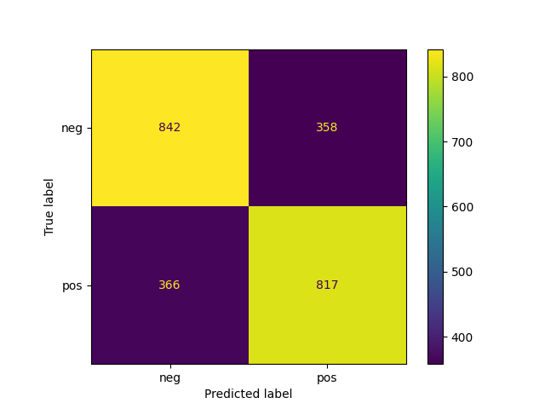
Best decision tree
The results for this model were better than the Base tree but not as good as NB
The confusion matrix
Accuracy | Precision | Recall | Fscore
0.6961812840956777 | 0.6961755745913101 | 0.6961812840956777 | 0.6961705826060184

Slide 11
Analyzing the results:
The model was able to predicate the correct label for over 69% of the reviews
For the pos label the system predicated 775 reviews that were pos and 370 reviews that were neg
For the neg label the system predicated 830 reviews that were neg and 408 reviews that were pos
The results were slightly better than the base tree since we used to calculate the entropy of each feature to determine the information gain which will help in choosing the root for the tree so we can get a smaller tree
But as in the previous models if we have a small number of features that are not discriminate like the case when we try to classify short reviews then even with using the entropy as a guide to choose the tree root we will still get a wrong label since the entropy will be high and this will increase the ambiguity about the correct label of the given review.

Slide 12
The Precision , the recall , the fscore
The results of The Precision and the recall and the fscore were similar to the accuracy and the reason of these results is the distribution of the data since the 2 labels are reparented equally as we saw in the distribution plot
When calculating the Precision, recall, fscore we used the weighted Harmonic mean which takes into account the weight of each class distribution and as we mentioned since we had an equal distribution the results were similar to the accuracy in the three models.

Slide 13
Contribution
Name | Student ID | Contributions

